Slide 1
The Sacraments of Healing.
Sacrament of Penance
Sacrament of Anointing of the Sick

Slide 2
Penance
The Sacrament of
Penance is one of the
sacraments of healing
and restoration.
Notes:
Reconciliation is officially called the Sacrament of Penance. In the past, it was also called Confession. These titles are all aspects of the meaning of the Sacrament.
It celebrates the call to repentance after a process of conversion of heart.
This includes confessing our sins and receiving the forgiveness of God through the ministry of the priest.
Through this process, a person is reconciled with the Church and continues to live as a disciple of Jesus Christ.
It is a celebration of God’s love and mercy.
It celebrates the call to repentance after a process
of conversion of heart.

Slide 3
peace begins with a stewardship of heart and is sustained through forgiveness and reconciliation.

Slide 4
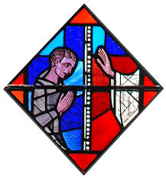
SACRAMENT OF RECONCILIATION FOR CHILDREN
https://www.youtube.com/watch?v=BdHl5CEsTas

Slide 5
Reconciliation in God’s story
The book of Genesis tells the story of the creation of the world and of man and woman. Created in God’s image they are blessed, sent forth to be fruitful and fill the earth. Hence Genesis explains the origins of the world and of human beings in the loving creativity of a good God.
Notes:
The account of ‘the Fall’ (Genesis 3) offers an
explanation as to why we do not always experience
the world as an idyllic garden, why evil exists, why
relationships are often characterised by disharmony
and how it is that we are alienated and distanced
from the God who made us ‘in his image and
likeness’. The book of Genesis suggests that the
human turning away from God results in the
disruption of creation and is the origin of human sin
and suffering and death.

Slide 6
Reconciliation
The rest of the Jewish-Christian scripture is devoted to an account of God’s great desire for the reconciliation and rehabilitation of creation. Throughout history, especially through the covenants, leaders, laws and prophets of Israel, God offers guides and remedies for the rupture caused by sin and holds out to the human race the hope of reconciliation.

Slide 7
In the New Testament
Jesus preached reconciliation, he
practised it, he called people to it, he
lived it and through the utterly faithful
witness of his death and resurrection he
brought it about.
In Jesus, God absorbed human violence
and sin and forgave it.
Those who belong to the Body of Christ
are called to do the same.

Slide 8
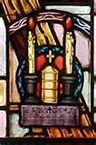
Key themes of the gospels
All the gospels in their entirety are
stories of the reconciliation of God
and the world in and through Jesus.
The whole point of the gospels is to
show that “All (reconciliation) is
from God, who through Christ
reconciled us to himself and gave us
the ministry of handing on this
reconciliation’ (2 Cor 5:18).

Slide 9
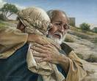
The Lost parables
Three beloved stories of
Reconciliation often called ‘the
gospel within the gospel’ occur in
Chapter 15 of Luke’s gospel.
The lost sheep
The lost coin
The lost son
Notes:
The Prodigal Son - Story Summary:
The story of the Prodigal Son, also known as the Parable of the Lost Son, follows the parables of the Lost Sheep and the Lost Coin.
Parable’s Main Theme
The parable's major theme is the unconditional love of the father, which reveals God's love of the sinner and justifies Jesus' own relationship with sinners. Luke addresses it to the Pharisees and Scribes who object to Jesus keeping company with sinners. "This man welcomes sinners and eats with them."
The references to joy in heaven show that the group of parables (The lost sheep, the lost coin and the prodigal son) give a lesson in God's loving mercy and explain the value of those whom others despise as lost. This parable stresses that the elder brother should not be jealous of the father's benevolent treatment of the sinful younger brother, and that fits the context of Jesus correcting the Pharisees' attitude towards sinners.
The parable
Jesus tells the story of a man who has two sons. The younger son asks his father to give him his portion of the family estate as an early inheritance. Once received, the son promptly sets off on a long journey to a distant land and begins to waste his fortune on wild living. When the money runs out, a severe famine hits the country and the son finds himself in dire circumstances. He takes a job feeding pigs. He is so destitute that he even longs to eat the food assigned to the pigs.
The young man finally comes to his senses, remembering his father. In humility, he recognizes his foolishness, decides to return to his father and ask for forgiveness and mercy. The father who had been watching and waiting, receives his son back with open arms of compassion. He is overjoyed by the return of his lost son! Immediately the father turns to his servants and asks them to prepare a giant feast in celebration.
Meanwhile, the older son is not one bit happy when he comes in from working the fields and discovers a party going on to celebrate his younger brother's return. The father tries to dissuade the older brother from his jealous rage explaining, "You are always with me, and everything I have is yours."
Points of Interest from the Story:
• Typically, a son would receive his inheritance at the time of his father's death. The fact that the younger brother instigated the early division of the family estate showed a rebellious and proud disregard for his father's authority, not to mention a selfish and immature attitude.
• Pigs were unclean animals. Jews were not even allowed to touch pigs. When the son took a job feeding pigs, even longing for their food to fill his belly, it reveals that he had fallen as low as he could possibly go. This son represents a person living in rebellion to God. Sometimes we have to hit rock-bottom before we come to our senses and recognize our sin.
• The father is a picture of the Heavenly Father. God waits patiently, with loving compassion to restore us when we return to him with humble hearts. He offers us everything in his kingdom, restoring full relationship with joyful celebration. He doesn't even dwell on our past waywardness.
• Reading from the beginning of chapter 15, we see that the older son is clearly a picture of the pharisees. In their self-righteousness, they have forgotten to rejoice when a sinner returns to God. Bitterness and resentment keeps the older son from forgiving his younger brother. It blinds him to the treasure he freely enjoys through constant relationship with the father.
Key verses and their background:
Give me the share of the property that will belong to me (v12). The younger son's request for his share was in keeping with the custom of the day though traditional wisdom counseled against it, of giving an inheritance before one's death.
distant country (v 13). A place far removed from the family's religious and cultural background.
feed the pigs (v 15). A shameful task for a Jewish boy, as according to Jewish law, pigs are unclean animals.
when he came to himself (v 17). The son's motivation was both self­preservation and genuine conversion.
he ran and put his arms around him and kissed him (v 20). This expresses the father's unconditional love for the son.
bring out a robe (v 22). Symbols of honour.
put a ring on his finger (v 22). A sign of authority in the family.
sandals on his feet (v 22). A sign of membership of the family as servants went barefooted.
get the fatted calf and kill it (v 23). Meat was not often eaten, so killing the fatted calf was a sign of an extravagant celebration.
was dead…is found (v 24). The son was fully restored to the family life.
his elder son… (v 25­32), This son shows attitudes of jealously and self-righteousness even though his inheritance rights are protected. The father reassures him of his constant loving presence 'you are always with me'. (Adapted from Lent and Easter units Diocese of Broken Bay)
Questions for Reflection:
Who are you in this story? Are you a prodigal, a pharisee or a servant? Are you the rebellious son, lost and far from God? Are you the self-righteous pharisee, no longer capable of rejoicing when a sinner returns to God? Maybe you've hit rock-bottom, come to your senses and decided to run to God's open arms of compassion and mercy? Or are you one of the servants in the household, rejoicing with the father when a lost son finds his way home?

Slide 10
Jesus empowers his followers to forgive and reconcile
“Receive the Holy Spirit whose sins you shall forgive, they shall be forgiven, whose sins you shall retain they shall be retained” (John 20: 22-23) is one of the key texts influencing the church’s understanding and practice of the sacrament of reconciliation.
Jesus confers upon Peter and the church which he will lead, his own authority to bind and loose. In Matthew 18:18 this same authority, given first to Peter, is given to the other apostles and hence to their successors.

Slide 11
New Testament Times
We can see in the scriptures how the early church dealt with personal sin and with those who separated themselves from the community through sin.

Slide 12
The Sacrament
Notes:
Beginnings of practising the sacrament of penance in the form of individual confession as we know it now, i.e. bringing confession of sins and reconciliation together, can be traced back to 11th century.
In 1215 the Fourth Council of the Lateran made it canon law that every Catholic Christian goes to confession in his parish at least once a year.
In 1907, Pope Pius X specifically reaffirmed the relevance of the Gospel of John to support the issue of the institution of this sacrament by Jesus himself.
Significant changes to the practice of reconciliation centred around the private nature of the confessional. In the early Church, publicly known sins were often confessed openly or publicly in church while private confession was still used for private sins.
Another change was to the form o f penance which was previously often done before absolution rather than after absolution.
In the early Church, the assigned penances were much more harsh. For example, it would not have been unusual for someone to receive a 10-year penance for committing the sin of abortion which the Catholic Church considers to be a grave or mortal sin. In time penances began to be lessened or mitigated.

Slide 13
The Sacrament
Notes:
During the 16th century, the sacrament of penance was changed dramatically from a social to a personal experience with the introduction of private confession. It was no longer an experience which must be presented in public and public penance enacted. It now took place in private in a confessional. It was a change from reconciliation with the Church to reconciliation directly with God.

Slide 14
The Sacrament
Notes:
The elements of the celebration are ordinarily these: a greeting and blessing from the priest, reading the word of God to illuminate the conscience and elicit contrition, and an exhortation to repentance; the confession, which acknowledges sins and makes them known to the priest; the imposition and acceptance of a penance; the priest's absolution; a prayer of thanksgiving and praise and dismissal with the blessing of the priest.

Slide 15
Vatican 11
The Second Vatican Council sought to reconcile the sacrament of reconciliation to its own history, particularly to the foundational periods of the early church.
Thus the 1973 rite of penance offers three options:

Slide 16
How do we celebrate the sacrament?
There are three forms of the celebration of penance.
Reconciliation for Individual Penitents (Rite I)
Reconciliation for Several Penitents with individual confession and absolution (Rite II)
Reconciliation for Several Penitents with general confession and absolution (Rite III)
Notes:
Celebration of reconciliation?There are three forms of the celebration of penance. Reconciliation for Individual Penitents (Rite I)
This form is celebrated by an individual person in the presence of the priest. The place where this happens is usually a Reconciliation Room (what used to be called a “Confessional’). A bible, a crucifix and candle are placed on a table in the centre of the space. The person may choose to sit facing the priest or to sit behind a screen and remain anonymous. The Rite begins with a greeting, followed by words of encouragement from the priest. After short reading from scripture, the person reflects on his/her circumstances and confesses his/her sins and seeks reconciliation. The priest offers advice and gives a penance that is meant to help in starting a new life and to remedy any weakness. The priest pronounces absolution and the rite concludes with a short thanksgiving.
Reconciliation for Several Penitents with individual confession and absolution (Rite II) This form of the Rite begins with a celebration of the Word – readings from scripture, hymns, prayers, a homily and an examination of conscience, followed by a call to repentance. Private confession and reconciliation follow. The Rite concludes with a short thanksgiving, and a blessing and dismissal of the gathered assembly.
Reconciliation for Several Penitents with general confession and absolution (Rite III) This form of the Rite follows the same pattern as Rite II, but does not include individual confession and reconciliation. It includes a communal prayer of confession and general absolution. The use of this form is restricted to emergencies and other special circumstances.

Slide 17
The first rite
Notes:
1st rite- Individual confession: Where the penitent has a one on one confession with the priest which is private.

Slide 18
When do we celebrate reconciliation?
Individual (Rite 1)
Reconciliation (Rite I) is usually celebrated at set times during the week in parishes (often on Saturday afternoon) and may be arranged at other times by appointment
Notes:
When do we celebrate reconciliation? Individual. This Rite is meant to give people the opportunity for personal prayer and individual spiritual direction to enable them to ‘set their lives on track’!

Slide 19
The second rite
Notes:
2nd Rite: communal celebration: A public celebration usually at an important time in the catholic year. In this rite they also have an individual confession as well.
The 2nd rite , communal celebration, is most regularly celebrated by parish communities for children making their first reconciliation. Schools support of this rite is most common in primary schools. In many cases the school supports the parish by assisting to prepare the children

Slide 20
When do we celebrate reconciliation?
Communal Reconciliation (Rite II)
is usually celebrated in parish communities during Advent and Lent and at other appropriate times during the year.

Slide 21
The third rite

Slide 22
The Sacrament
Notes:
Some elements of the ritual have stayed the same:
Beneath the changes in discipline and celebration that this sacrament has undergone over the centuries, the same fundamental structure is to be discerned. It comprises two equally essential elements:
on the one hand, the acts of the man who undergoes conversion through the action of the Holy Spirit: namely, contrition, confession, and satisfaction;
on the other, God's action through the intervention of the Church.
The Church, who through the bishop and his priests forgives sins in the name of Jesus Christ and determines the manner of satisfaction, also prays for the sinner and does penance with him. Thus the sinner is healed and re-established in ecclesial communion.

Slide 23
Who celebrates reconciliation?
Baptised members of the Roman Catholic Church who feel called to be reconciled with God and with the faith community can take part in the sacrament of penance.
Notes:
Who celebrates reconciliation?
This call to conversion and reconciliation occurs when one considers, judges and changes one’s life in the light of God’s love revealed in the person of Jesus Christ. Prayer and participating in the Eucharist are the regular means of asking for forgiveness and being reconciled with God and the community. However, there are times when the faithful need the sacrament of penance/reconciliation in their struggle to be forgiven and forgiving, to discover anew the gift of God’s saving action in their lives and to be strengthened to continue living as disciples of Jesus.

Slide 24
With children
EXAMINATION OF CONSCIENCE
Responsibilities to God:
Responsibilities to others:
Notes:
Responsibilities to God:
Have I prayed every day?
Have I prayed my morning prayers and night prayers?
Have I prayed with my parents and family?
Have I been moody and rebellious about going to
church on Sunday with my family?
Have I asked the Holy Spirit to help me do
what is right?
Responsibilities to others:
Have I been obedient and respectful to my parents?
Have I lied or been deceitful to them or to others?
Have I talked back to parents, teachers or other adults?
Have I been selfish toward my parents, brothers,sisters and teachers, or my friends and schoolmates?
Have I gotten angry at them? Have I hit anyone?
Have I held grudges or not forgiven others?
Have I treated other children with respect or have I made fun of them and called them names?
Have I used bad language?
Have I stolen anything? Have I returned it?
Have I performed my responsibilities, such as homework and household chores?
I been kind and generous with my friends?

Slide 25
The process
Meet with the priest
Tell your sins
Listen to the priest / Penance
Act of Contrition/Receive absolution
Go quietly
Notes:
Kneel, make the sign of the cross and say, “Bless me Father for I have sinned.”
Tell the father how long it has been since you last confessed. Egs.” It has been 1 month since my last confession.” If it is your first time then just say “this is my first confession.”
Tell the father your sins and how you have hurt God your loving father and when you have finished say “For these and all my sins, I am truly sorry.” Then tell the father how you are going to repent. (so as not to commit the sin again) egs. I will reflect on how Jesus died on the cross for me each time I am tempted to use bad words.
Listen to the Father if he has any advice for you, after which he will give you absolution.
Say the Act of Contrition.
Listen to the words of the Father as he gives you absolution.
Thank the Father out of politeness and respect and you might even say “Bless you Father”
Go quietly
Oh my God, I am so sorry that I have sinned against you. Because You are so good and with the help, I will not sin again.

Slide 26
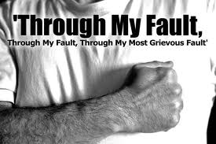
Reconciliation in the Mass
Notes:
IN THE MASS:
Penitential Rite:
In the Penitential Rite - as in the sacrament of Reconciliation - our sorrow is only part of the process - far more important - and what, in the end, makes the difference is the love of God and God’s desire to heal us. This ritual in many school masses is another form of reminding students of the elements of the ritual and the application of the ritual of reconciliation other than the formal sacrament.
In today’s cultural climate of a growing consumerist society, the social space once reserved for family and religious celebrations and attending mass has been crowded out by consumerist activities. ( Bouma, 2006) Students in our schools are no longer attending church as their parents may have when they were young. A growing lack of relevance of the mass to many of today’s youth is another contributor to declining numbers. The importance of regular mass and liturgical celebrations at schools is increasing with the school often being the main exposure to religious celebrations and rituals for these students.
I confess to almighty God
and to you, my brothers and sisters,
that I have sinned through my own fault - we strike our breast -
in my thoughts and in my words,
in what I have done,
and in what I have failed to do;
and I ask blessed Mary, ever virgin,
all the angels and saints,
and you, my brothers and sisters,
to pray for me to the Lord our God.
May almighty God have mercy on us,
forgive us our sins,
and bring us to everlasting life.
Amen.
In the Roman Catholic Church, the Penitential Rite is a part of the Introductory Rites of the Mass. The Penitential Rite is a time of reflection on one's sins and a prayer for God's mercy. While the Penitential Rite is similar to the Sacrament of Penance and Reconciliation, the priest however, does not offer absolution.

Slide 27
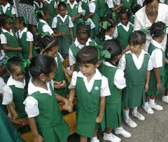
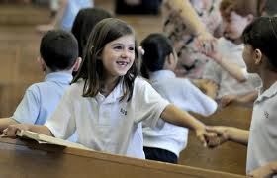
In the Mass
Notes:
IN THE MASS
The sign of Peace
The Sign of Peace was reintroduced into the Mass when the Liturgy was reformed after Vatican II. The inclusion of the sign of peace again was contentious among many as some were more , or less, comfortable with moving around and touching others. It may be that this single gesture summarises much of what Liturgical reform was about.
This is another ritual of reconciliation, although without the confession and absolution – a simple ritual which children can again connect with as a ritual for peace making and reconciliation with others around them.

Slide 28
Reconciliation rituals
Notes:
SECULAR RITUALS FOR PEACE & RECONCILIATION
Many secular, although quite spiritual, rituals surround us and are present in other cultures as well as our own. Contemporary Australian culture is quite diverse and more multicultural in its composition than ever before.
An awareness of and acceptance for others and the rituals they perform is fundamental to the development of a tolerant society.

Slide 29
Reconciliation in Australia
Notes:
RECONCILIATION IN THE AUSTRALIAN CULTURE
The Australian story of the treatment of indigenous when white settlement began changed somewhat when the then Prime Minister, Kevin Rudd, apologised for the treatment of the aboriginal families and the removal of the children to live with white settlers. The change in administration led to a national apology from the government for the Stolen Generations, and the country as a whole celebrates Sorry Day. The new administration also reversed the country’s opposition to the UN Declaration on the Rights of Indigenous Peoples.
Educators need to respond to public acts and the practice of observing important days which mark the process and progress of reconciliation with indigenous people in this country. Many schools carry out public acts for support of the day and many involve students in l

Slide 30
Vatican 11
The Second Vatican Council sought to
reconcile the sacrament of
reconciliation to its own history,
particularly to the foundational periods
of the early church.
Thus the 1973 rite of penance offers
three options:
Notes:
Rite 1: For the reconciliation of individual penitents (for example,
the Saturday afternoon confessions)
Rite 2: For the reconciliation of several penitents with individual
confession and absolution (for example, the Advent and
Lent penance services)
Rite 3: For the reconciliation of several penitents with general
absolution (only allowed in exceptional cases)
.

Slide 31
Sin affects our relationships
Sin affects not only one's relationship with God
but also one's relationship to the Body of
Christ, the church.
Notes:
The sacrament must be able to bring about a personal encounter with God, mediated by a spiritual mentor (priest-confessor), that furthers a
penitent's lifelong conversion.
Therefore, the sacrament is not merely about the forgiveness of sins (a personal experience between a penitent and God); it is supposed to
celebrate and effect reconciliation, which is a communal, structural reality that graces us with the ability to be the Body of Christ more effectively.
While the privacy of confession to a priest is important, the dynamic of
reconciliation is a public reality since it involves the church community in
some way.
The rite of penance has to genuinely express how a parish recognizes
itself as a reconciling community in which every member is a sinner in
need of God's mercy and all members are responsible for bringing the
mercy of God to bear on one another's lives.

Slide 32
The process
Meet with the priest
Tell your sins
Listen to the priest / Penance
Act of Contrition/Receive absolution
Go quietly
Notes:
Kneel, make the sign of the cross and say, “Bless me Father for I have sinned.”
Tell the father how long it has been since you last confessed. Egs.” It has been 1 month since my last confession.” If it is your first time then just say “this is my first confession.”
Tell the father your sins and how you have hurt God your loving father and when you have finished say “For these and all my sins, I am truly sorry.” Then tell the father how you are going to repent. (so as not to commit the sin again) egs. I will reflect on how Jesus died on the cross for me each time I am tempted to use bad words.
Listen to the Father if he has any advice for you, after which he will give you absolution.
Say the Act of Contrition.
Listen to the words of the Father as he gives you absolution.
Thank the Father out of politeness and respect and you might even say “Bless you Father”
Go quietly
Oh my God, I am so sorry that I have sinned against you. Because You are so good and with the help, I will not sin again.

Slide 33
Anointing of the sick

Slide 34
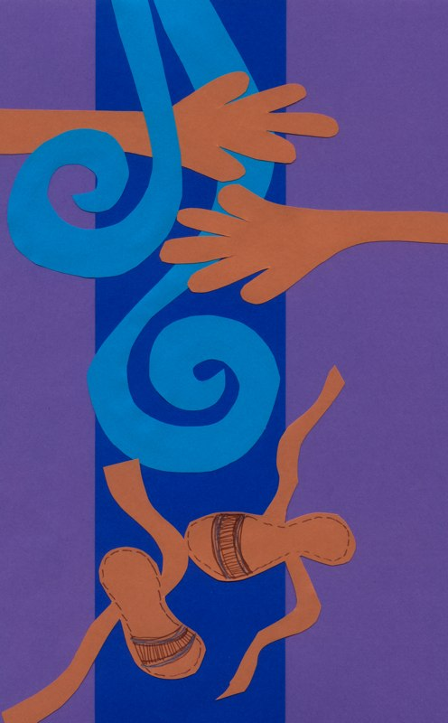
The Sacrament
The Anointing of the
Sick is a sacrament of
the Church for those
whose health is
Seriously impaired by
sickness or old age.
Notes:
It is a source of healing for the
sick rather than the final act
of the church for the dying.
The Sacrament enables the sick or aged person to be anointed with the oil of the sick, to experience the healing
and strength of JesusChrist and to be supported by a praying community
The sacrament may be celebrated during Mass, or at a hospital or nursing home, or in the person’s home. It is a
celebration of the church where members of the church offer those who are sick the support of faith and prayer.

Slide 35
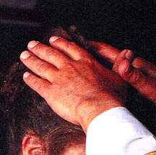
When do we celebrate it?
The sick and their families
and friends are encouraged
to notify a priest and ask for
the sacrament at the onset
of serious illness.
Notes:
Such gatherings allow the sick or elderly to experience the support of
the community. The local parish priest or a member of
the pastoral team should be contacted to arrange for the Anointing of the Sick.
Parish communities offer
opportunities for the Anointing
of the Sick several times during
the year.

Slide 36
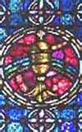
Laying of the hands
The priest lays hands on the
sick, a reminder of God's
power to heal and
strengthen; he prays over
them then anoints them
with the oil of the
sick.
Notes:
Those who are present during the
celebration are also reminders of the
presence of Christ, especially if they
are caring for the person who is ill.

Slide 37
Teaching the Sacraments of healing
According to the Catechism of the Catholic Church through the two sacraments of healing: the sacrament of Penance and the sacrament of Anointing of the Sick the work of Jesus is continued.
Notes:
As Jesus forgave the sins of the paralytic and restored him to bodily health, and has willed that his Church continue, in the power of the Holy Spirit, his work of healing and salvation, even among her own members. (CCC 1421

Slide 38
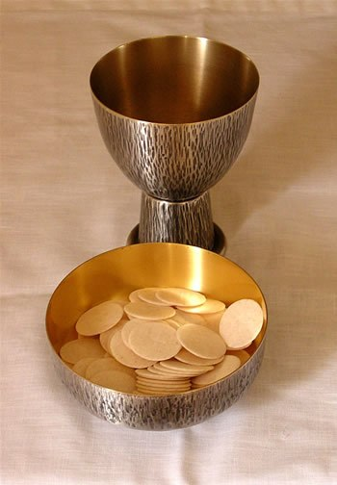
OF INTEREST
Eucharist offered to the
Dying is called
Viaticum
‘nourishment for the
Journey to God’. (Via
from the Latin on the
way.)

Slide 39
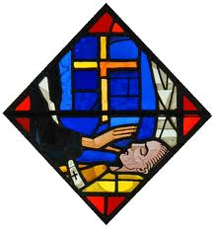
In Summary
The sacrament of the Anointing of the Sick
heals, frees and prepares us to continue our journey of life towards God.

Slide 40
The sacrament is administered by
anointing the forehead and Hands
with chrism.
Being seriously ill or frail is sufficient
reason to receive the
sacrament.

Slide 41
Students can be directed
to gospel stories of Jesus‘
special love and healing (cf. Mt 9:1-8;
http://www.youtube.com/watch?v=F5rzgOOVYvQ

